Slide 1
Zomato Restaurant Rating Prediction Using Machine Learning
Machine Learning Project
By:
Abhishek R A MBA (AI & DS)

Slide 2
Abstract
Overview of the project, importance of rating prediction, and role of ML models
Online food delivery platforms rely heavily on restaurant ratings.
The dataset includes cuisines, cost, city, service options, and customer votes.
ML models predict ratings based on structured restaurant attributes.
XGBoost achieved the best accuracy with an RMSE of 0.3100.
The project helps customers, restaurants, and food-tech platforms make better decisions.

Slide 3
Introduction
Importance of online restaurant ratings and use of ML for prediction.
Restaurant ratings strongly influence customer decisions.
Zomato provides large-scale restaurant data across Indian cities.
Machine Learning helps analyze complex patterns and predict ratings.
Ratings depend on service, price, cuisine variety, and customer engagement.

Slide 4
Background
Growth of Zomato, customer behavior, and data-driven decision making.
Zomato is one of India’s largest food discovery platforms.
Contains detailed information on cuisines, locations, and customer feedback.
Traditional statistics cannot capture nonlinear relationships in the data.
Machine learning models can learn patterns and predict outcomes accurately.

Slide 5
Problem Statement
Identify key variables, predict ratings, assist stakeholders.
Users find it hard to identify the best restaurants among thousands.
Ratings depend on multiple features that customers don’t easily interpret.
Key questions:
What features influence ratings the most?
Can ML models accurately predict ratings?
How can predictions help businesses and customers?

Slide 6
Objectives
Primary and secondary objectives of the ML project.
Primary Objectives
Identify major factors influencing restaurant ratings.
Build ML models to predict ratings.
Compare Linear Regression, Random Forest, and XGBoost.
Select the best-performing model.
Secondary Objectives
Perform EDA and generate visual insights.
Apply feature engineering and cluster-based features.
Provide actionable insights for stakeholders.

Slide 7
Significance
Importance for customers, restaurants, and food-tech platforms.
For Customers:
Helps them choose better restaurants.
Provides transparency about factors influencing ratings.
For Restaurants:
Shows factors that improve ratings.
Helps in strategic planning (pricing, menu, delivery).
For Food-Tech Platforms:
Improves recommendation and ranking algorithms.
Enhances customer experience.

Slide 8
Scope of the Study
Dataset focus, modeling scope, exclusions.
Uses structured restaurant-level data from Zomato.
Focused on Indian restaurants for consistency.
Models built for regression tasks.
Excludes sentiment analysis and real-time predictions.
Includes feature engineering (encoding + clustering).

Slide 9

Data Acquisition
Description of dataset source and relevance.
Data sourced from publicly available Zomato metadata.
Includes 9,551 entries; filtered to 8,652 Indian restaurants.
Contains 21 attributes: numerical, categorical, and geographical.
Suitable for ML because of variety and volume.

Slide 10
Dataset Description
Features include: City, Cuisines, Cost, Votes, Delivery options, Ratings.
Numeric data: cost, votes, latitude, longitude.
Categorical data: city, cuisines, rating text.
Binary data: online delivery, table booking.
Target variable: Aggregate Rating.

Slide 11
Data Quality Issues
Missing values, duplicates, outliers, formatting issues.
Missing values in cuisines and rating fields.
Duplicate restaurant entries found and removed.
“Yes/No” fields converted to binary values (1/0).
Outliers in votes and cost identified.
Imbalanced city representation (Delhi NCR dominant).

Slide 12
EDA Overview
Exploratory Data Analysis
Ratings follow a near-normal distribution (3.0–4.5).
Delhi NCR has the highest number of restaurants.
Popular cuisines: North Indian, Chinese, Fast Food.
Votes show strong positive correlation with ratings.
Online delivery and table booking improve rating averages.

Slide 13
Key EDA Visual Insights
Correlation, delivery impact, booking impact.
City-wise Count: New Delhi > Gurgaon > Noida.
Cuisine Word Cloud: highlights frequently offered cuisines.
Correlation Heatmap: votes most correlated with rating.
Service Impact: delivery and booking → slightly higher ratings.
Rating Distribution: peak around 3.5 to 4.2.

Slide 14
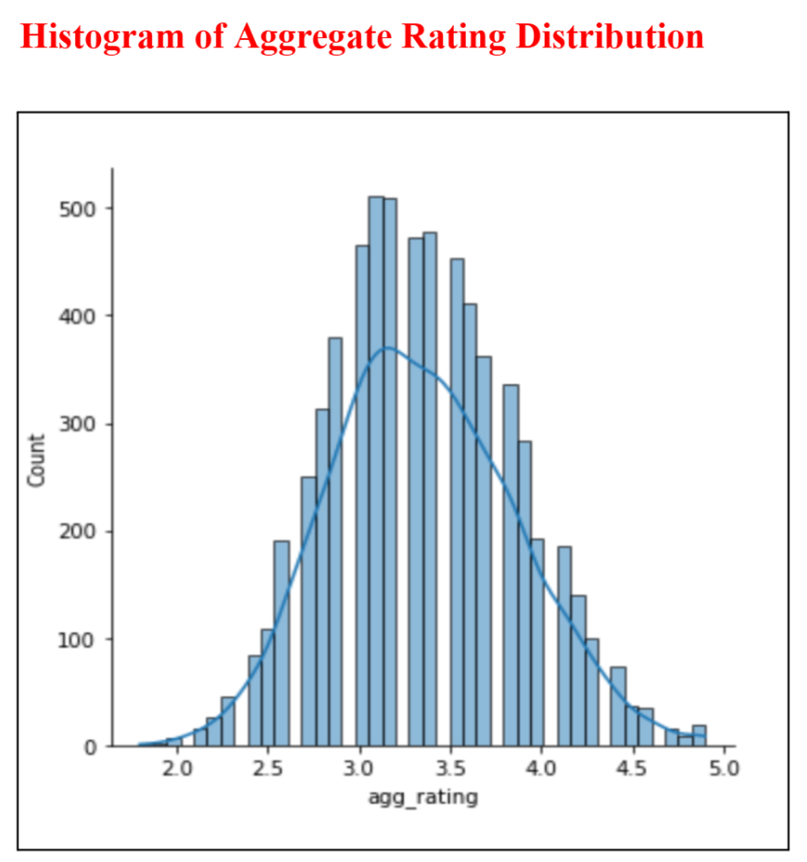
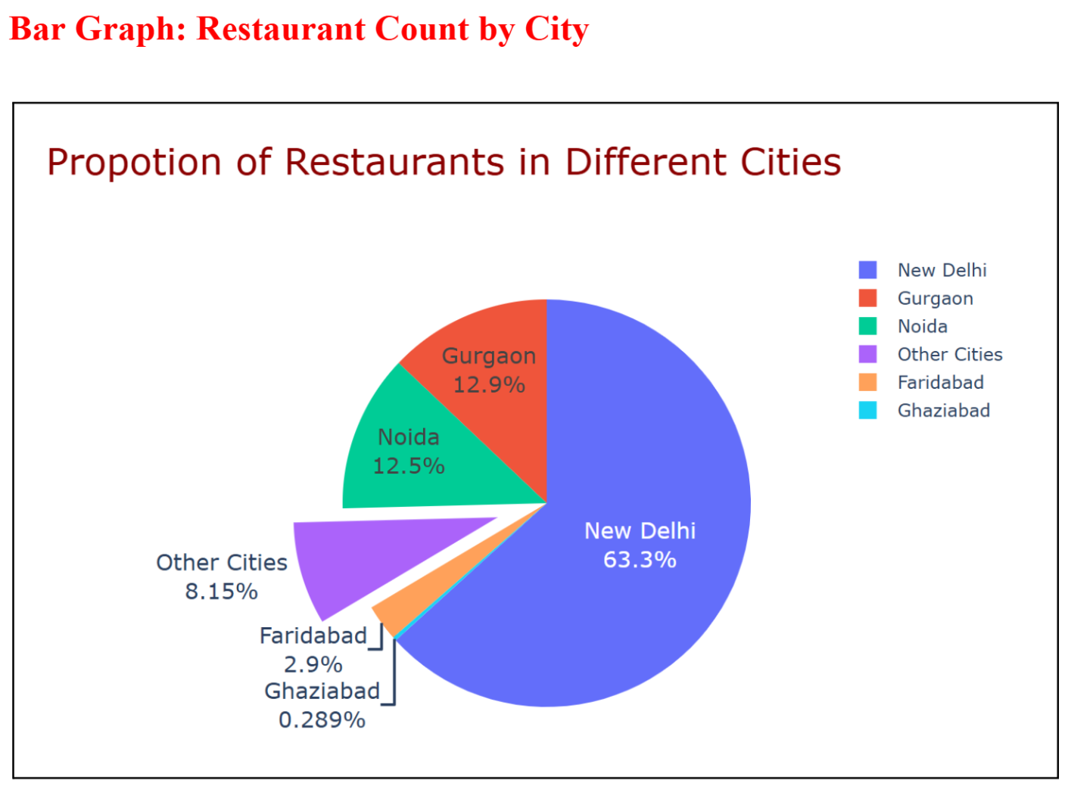
DATA VISUALISATIONS

Slide 15
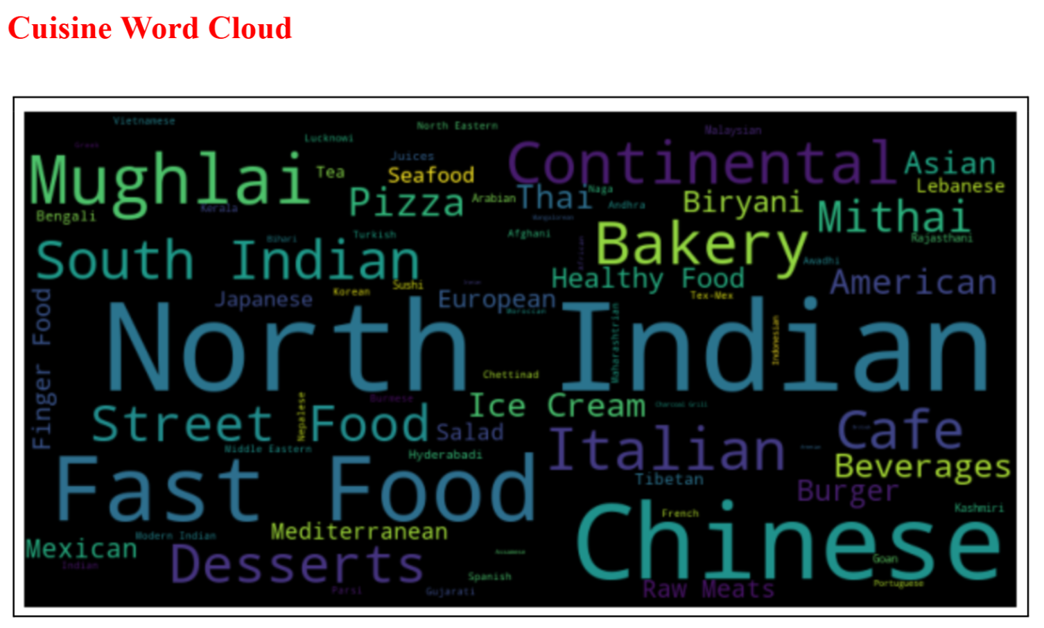
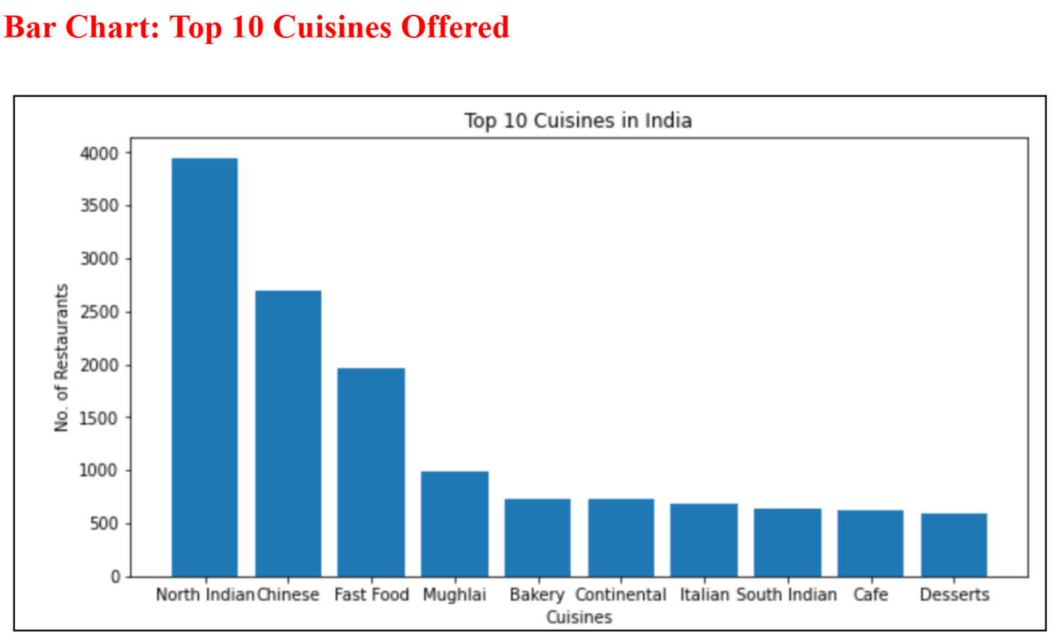
DATA VISUALISATIONS

Slide 16
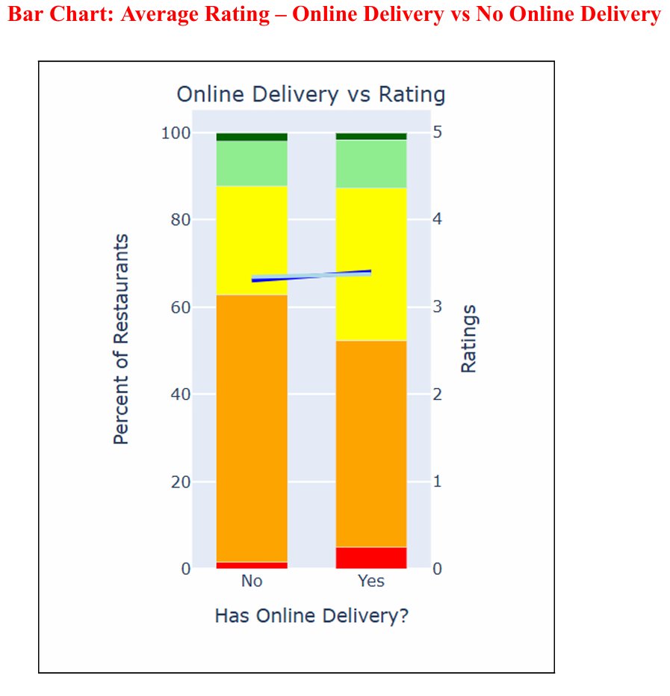
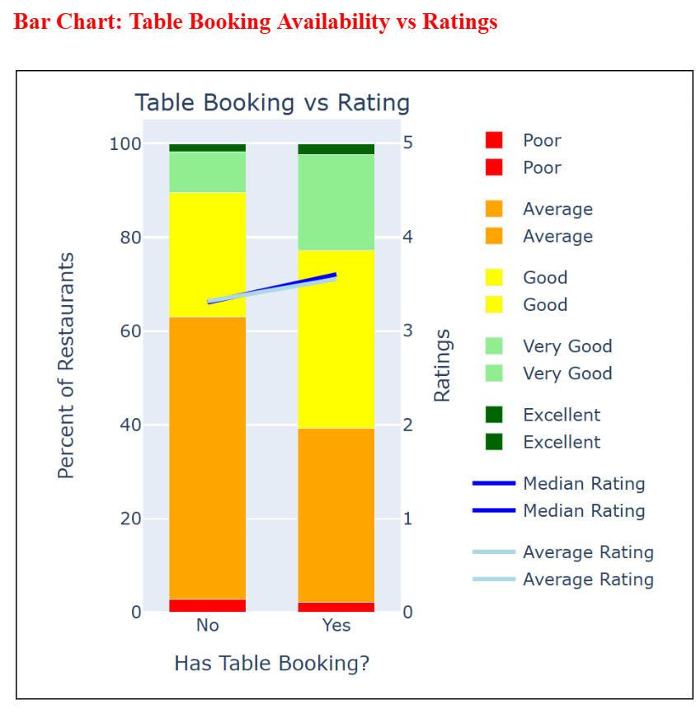
DATA VISUALISATIONS

Slide 17
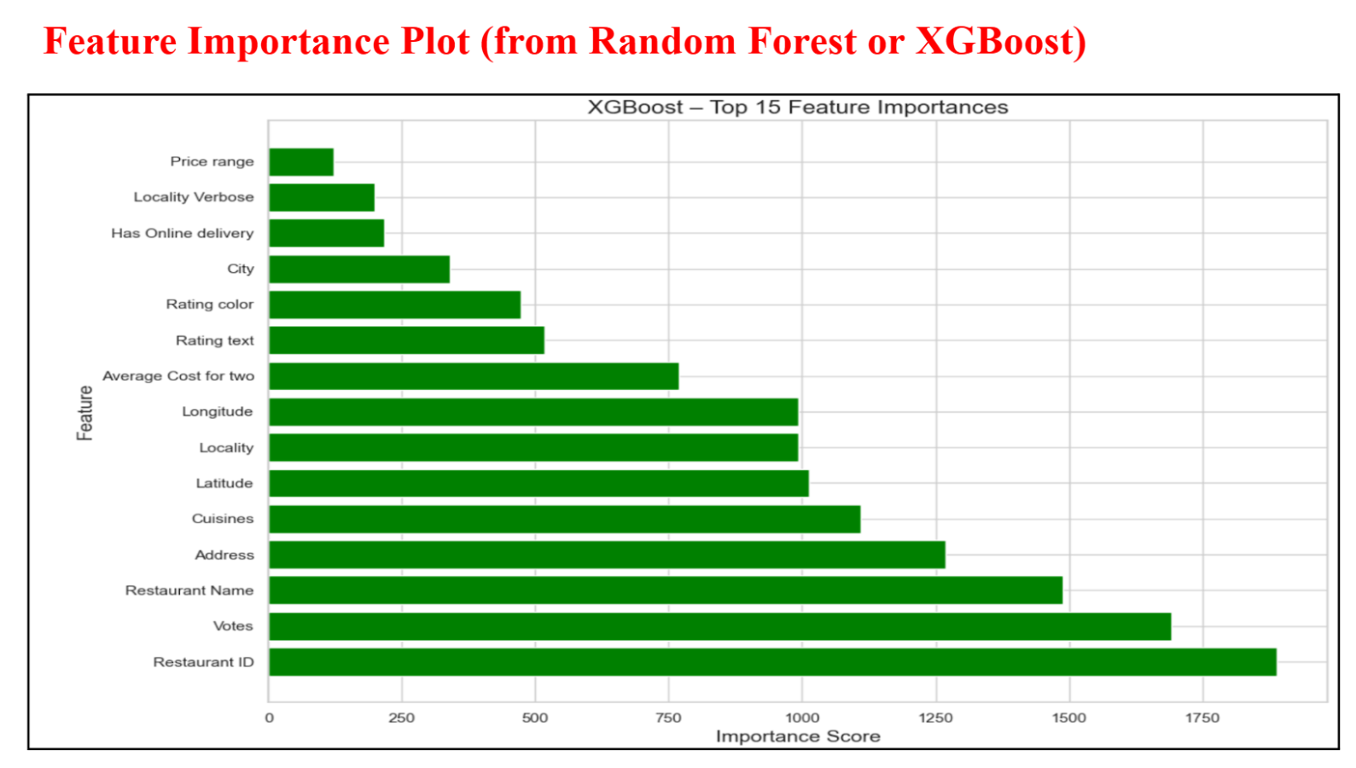
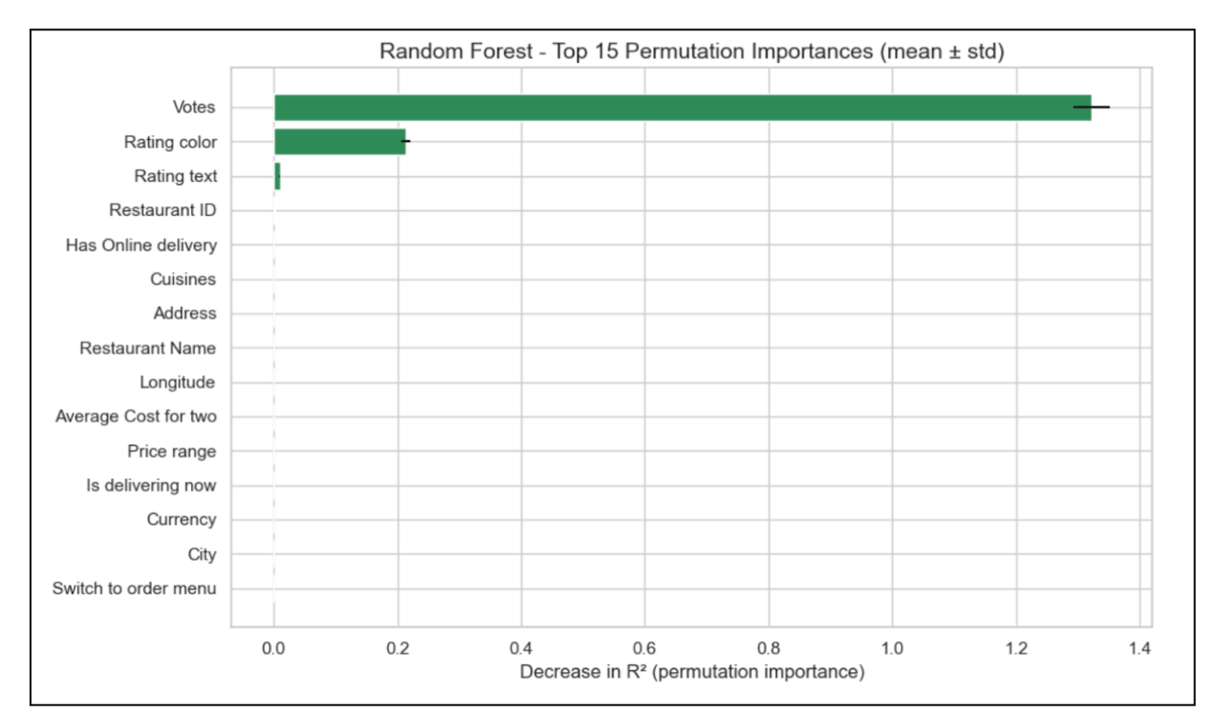
DATA VISUALISATIONS

Slide 18
Feature Engineering
Encoded categorical features using Label Encoding.
Created Cuisine Count as a new feature.
Selected top repeating cuisines for binary encoding.
Created an 8-cluster K-Means geographic feature from lat-long.
Improved XGBoost accuracy using the cluster feature.

Slide 19
ML Algorithms Used
1. Linear Regression
Baseline model
Did not capture nonlinear patterns
R² Test: 0.39–0.46
2. Random Forest Regressor
Captures complex relationships
R² Test: 0.955
RMSE: 0.322
3. XGBoost Regressor
Most powerful boosting model
R² Test: 0.9578
RMSE: 0.3100
RMSE: 1.10–1.17

Slide 20
Model Comparison
Model | R² Test | RMSE
Linear Regression | 0.39–0.46 | 1.10–1.17
Random Forest | 0.955 | 0.322
XGBoost | 0.9578 | 0.3100
XGBoost is the best-performing model.

Slide 21
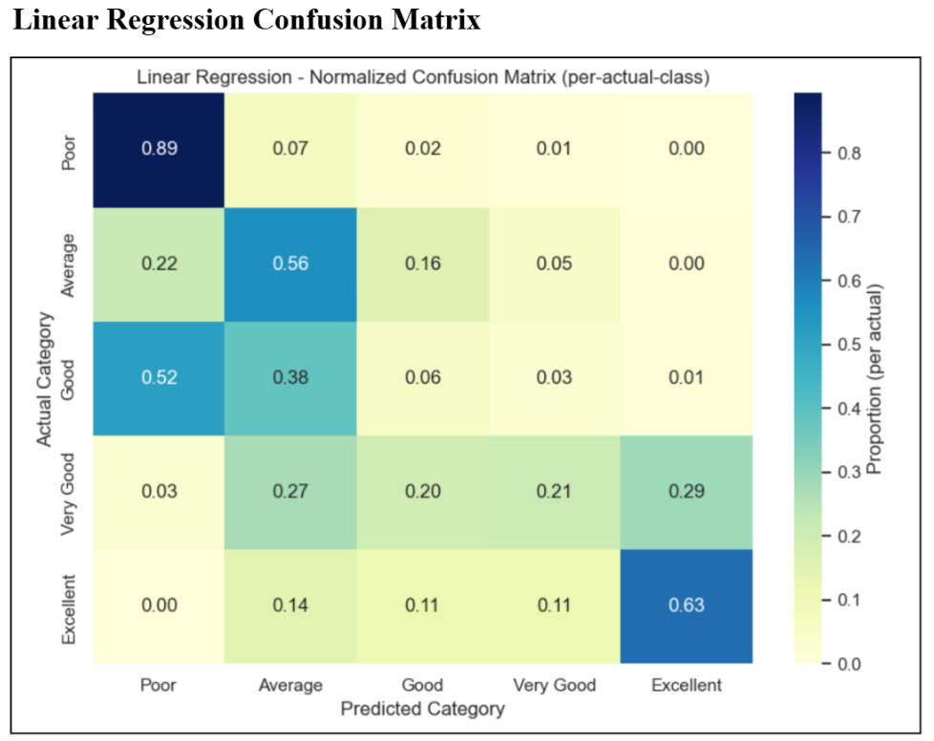
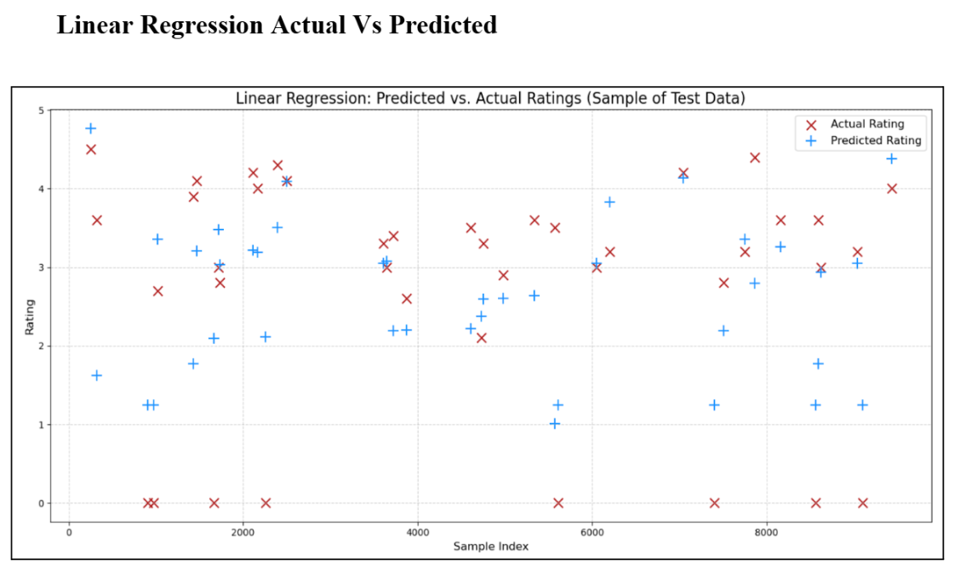
DATA VISUALISATIONS Linear Regression

Slide 22
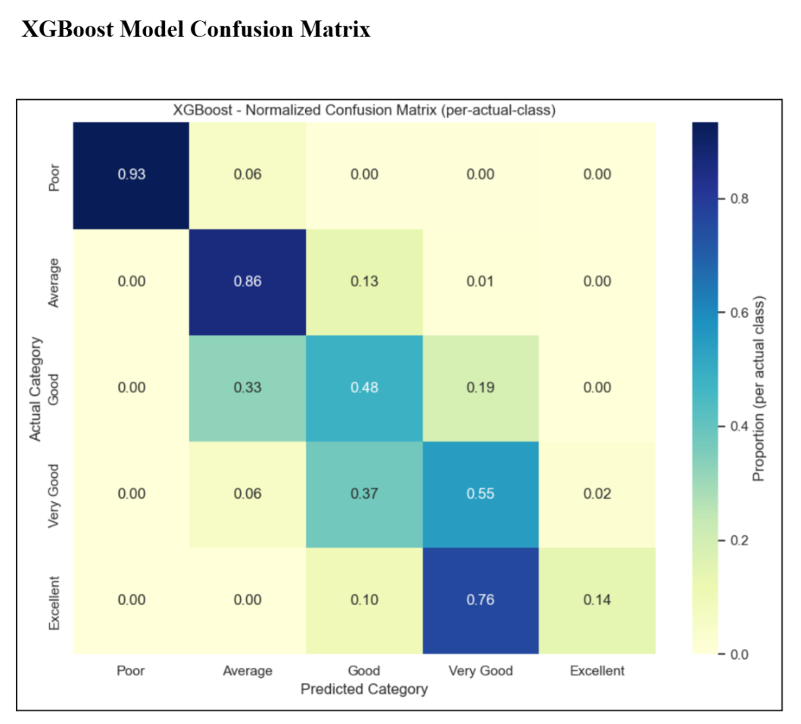
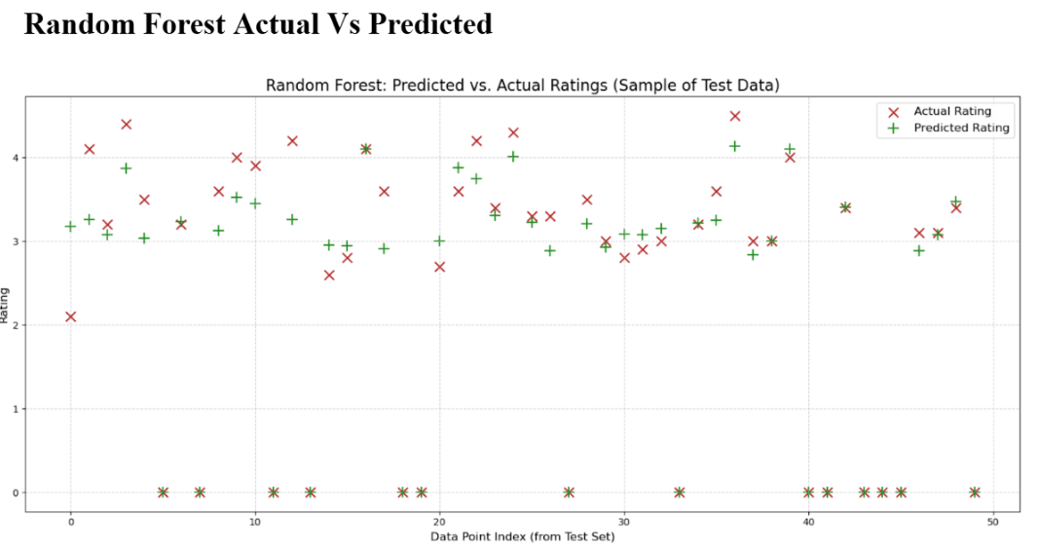
DATA VISUALISATIONS Random Forest Model

Slide 23
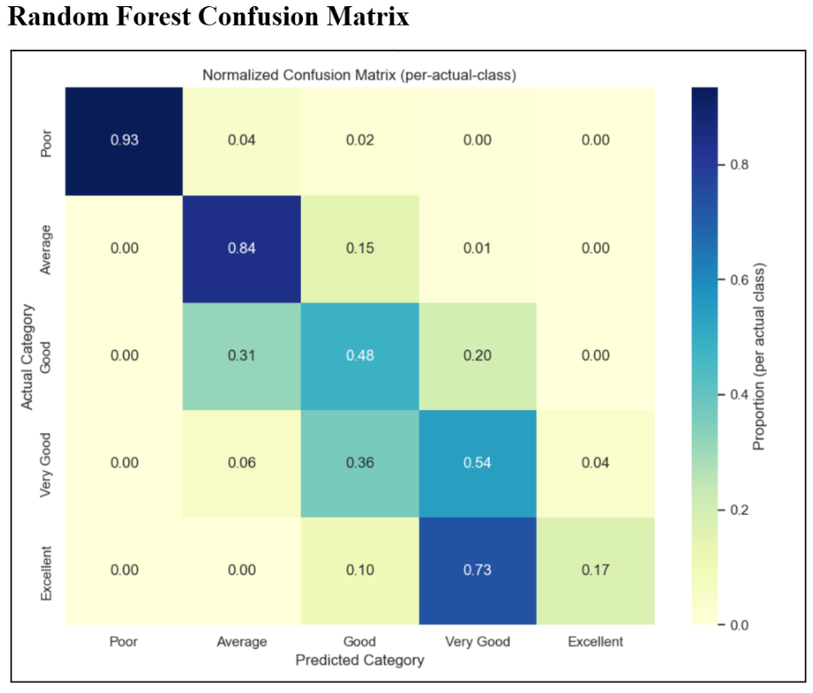
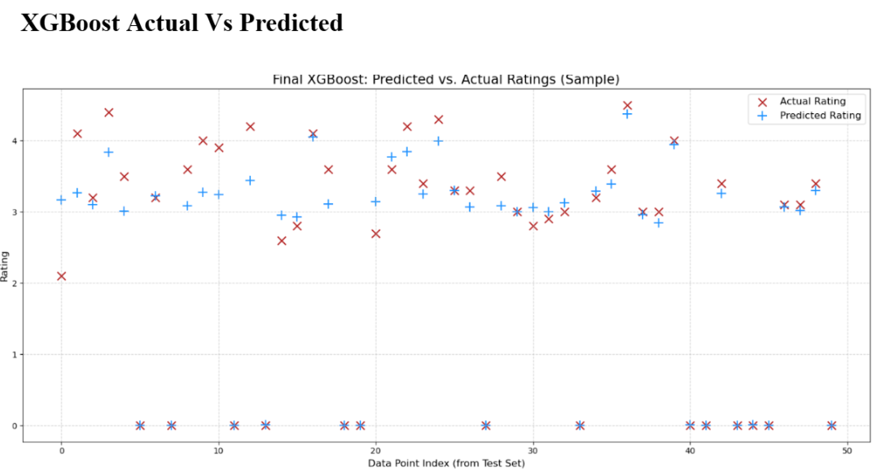
DATA VISUALISATIONS XGBoost Model

Slide 24
Feature Importance
Most influential features:
Votes (highest impact)
Price Range
Cuisine Count
Online Delivery Availability
Table Booking
Top Cuisines (North Indian, Chinese, Fast Food)
These features strongly influenced predicted ratings.

Slide 25

Results Interpretation
Ratings depend more on customer engagement (votes) than cost.
Cuisines and service features also play a crucial role.
XGBoost predicts ratings with high precision.
Predicted vs actual plots show strong alignment.

Slide 26
Conclusion
Machine learning models can predict restaurant ratings accurately.
XGBoost performed best with R² = 0.9578.
Voting patterns, cuisine diversity, and service features influence ratings the most.
The project proves the importance of data-driven insights in the food service industry.

Slide 27

Future Scope
Apply NLP on customer reviews for sentiment-based predictions.
Include time-series features to study seasonal changes.
Expand dataset to smaller Indian cities.
Use deep learning models for complex pattern detection.
Deploy prediction system as a real-time recommendation engine.

Slide 28

THANK YOU

